Slide 1
Micro Credit Defaulter
Submitted by:-M Sai Pujith Reddy

Slide 2
Problem Statement
To predict whether the customer will be paying loan amount in 5 days or takes more than 5 days to payback loan.
If the customer is taking more than 5 days to pay loan he is considered as defaulter else non defaulter
The target column in our project is label where code : -
0 : Non – Defaulter
1 : Defaulter

Slide 3
Data Processing
In the process of understanding the columns we found:
No NaN or null data is present in the dataset
All the columns are either integer type or float type except ‘msisdn’,’pcircle’,’pdate’ columns which is object type.
‘Unnamed: 0’ column is index column of dataset
Further we understood unique variables of object data type is as follows:
Msisdn = is unique id numbers
Pcircle= coded as ‘UPW’ in all columns
Pdate= dates of loan taken

Slide 4
Exploratory Data Analysis
SUMMARY STATISTICS
1. Data Description
In this process we analyze how data is spread and is their any outliers found.
statistical details like difference between :
mean & Standard Deviation
Percentiles like minimum and Q1, Q3 and max, mean and Q2
to make a comparative analysis

Slide 5
Exploratory Data Analysis
In Descriptive Statistics we found the outliers are high on upper limit i.e. Q3 and maximum variables and the data is dispersed exceedingly in following columns:
Aon
last_rech_date_ma
last_rech_date_da
Medianmarechprebal30
sumamnt_ma_rech90
fr_da_rech30

Slide 6
Exploratory Data Analysis
SUMMARY STATISTICS
2. Correlation of attributes with ‘label’ column
Number of times main account was recharged in last 30 and 90 days
Total amount of recharge in main account over last 30 days and 90 days
Number of loans taken by the user in last 30 days
Total amount of loan taken by users in last 30 days and 90 days.
are the columns comparatively highly positive correlated with label column.

Slide 7
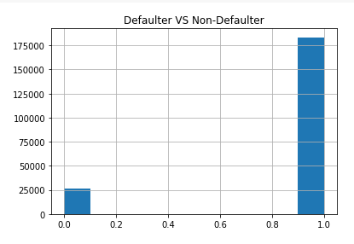
Exploratory Data Analysis
Uni variate analysis
Analyzing the counts of target column ‘label’ we found the population has not been equally distributed among defaulters and non defaulters

Slide 8
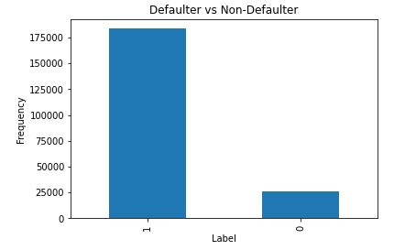
Exploratory Data Analysis
Uni variate analysis
Further analysis each column under two category(defaulter, non defaulter), we found number of times main account got recharged

Slide 9
Exploratory Data Analysis
We cannot make more such comparative analysis or derive any decisions as there is more population non defaulters
So further we making Bi variate analysis
Bi variate analysis between highly correlated variables with label column is anayzed

Slide 10
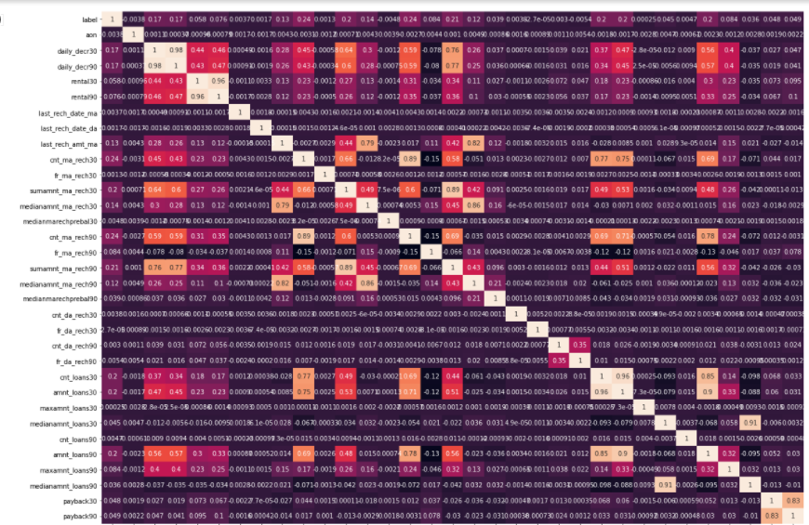

Slide 11
Data Analysis & Data Cleansing
Assumptions
Unamed column is similar to index hence we cannot make decision with this column so we will drop the column.
Pcircle column has ‘UPW’ in all the columns hence we cannot make any productive result analyzing this column, so we will drop the column.
Msisdn column again has unique id of the customers hence we remove this column

Slide 12
Data Analysis & Data Cleansing
Pdate column is in DDMMYYYY format, so we will drop the column.
Undestood there is outliers in all columns after visualizing in bar plot and analyzing extent of data being skewed.
Checked outliers removal process and found
Zscore will remove 22.96%
Outliers removing process is not recommended as we will lose huge data.

Slide 13
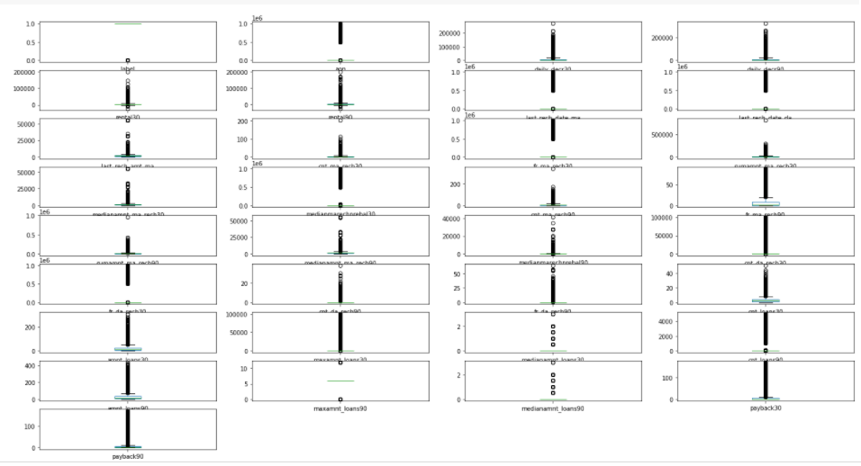

Slide 14
Model Building
X is assigned with all variables.
Y is assigned with label column
Split data into training and testing set
Tested with 30% of the data

Slide 15
Algorithms Adopted
LogisticRegression
SVC
DecisionTreeClassifier
KNeighborsClassifier
RandomForestClassifier
AdaBoostClassifier
GradientBoostingClassifier
BaggingClassifier

Slide 16
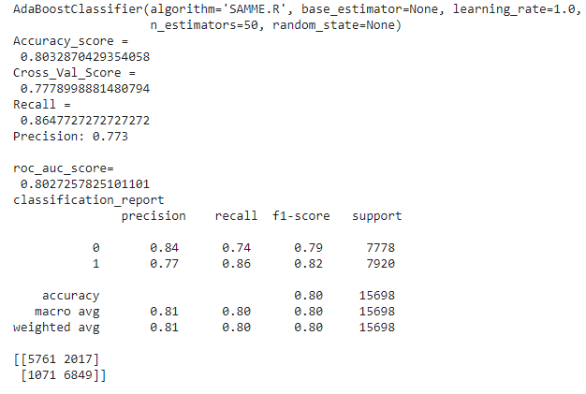
Interpretation of Results

Slide 17
Interpretation of Results
We found AdaBoost Classifieras the best fit algorithm while comparing accuracy score, cross validated score, metrics, GridSearchCV and AUC ROC curve of all the other algorithms in the prediction process.

Slide 18
THANK YOU

